Slide 1
Multimedia Presentation on Canadian Landscape

Slide 2
Introduction
Just like other nations, Canada has various landscapes.
They are highly valued by its citizens.
The Canadian landscape to be discussed is the social landscape (Chalmers, 2019).
It directly involves the lives and well being of the people.
The social life of people is very important.
Notes:
Highly valued by its citizens as well as other nations that recognize what Canada has.
The social life of people is very important because it is what shows how people co-exist among themselves and with their visitors or tourists, it defines them

Slide 3
continuation
Theme of love, care and social responsibility.
Canadians show compassion
They are humane toward the poor.
Notes:
The theme is that of love, care and social responsibility towards the poor, the needy and marginalized groups in society.
Numerous poets, singers an other artists have come forward to celebrate and acknowledge the giving, sharing as well as the responsibility nature of the Canadian people.

Slide 4
POEM
THE SUMMER CAMP by F.R. Scott
Here is a loving little camp
Built among the Leurentian hills
By a children's welfare society
Which is entirely supported by voluntary contribution
All summer long underprivileged children scamper about

Slide 5
POEM
THE SUMMER CAMP by F.R. Scott
And it is astonishing how soon they look happy & well
Two weeks here in the sun & air
Through the charity of our wealthy citizens will be a wonderful help to the little lots
When they return for a winter in slums

Slide 6
POEM EXPLANATION
The poem acknowledges sharing of Canadians.
They contribute in helping the needy.
They form charity organizations to spearhead the good work.
Canadians are happy putting a smile on each others face (Chalmers, 2019).
Sharing is a virtue they adore most.
Notes:
The poem is based on the good work that the people of Canada cares for the less fortunate that they form a charity organization that organizes camps for the children living in the slums.
The charity organization have built camps where the sum kids an go hiking while being taught the social values without paying anything. The children get to enjoy what the kids from wealthy family easily afford but to them it is a privilege.
It is evident that the people of Canada enjoy seeing each other happy thus the theme of love, care and sense of responsibility being portrayed.
This is a great social virtue that makes the people of Canada unique in their own small ways.

Slide 7
POEM EXPLANATION
Tone evident is that of happiness.
The author appreciates the efforts of charitable people.
Poetry has been used to express the gratitude of the society (Harms et al., 2018).
The less fortunate are happy getting a helping hand.
Notes:
The tone in the entire poem is that of happiness and appreciation.
The author recognizes the efforts of the Canadian wealthy society and appreciates them through writing in order to help promote the virtue throughout the other generations.
Poetry is a way of communication that is passed from one generation to the other.

Slide 8
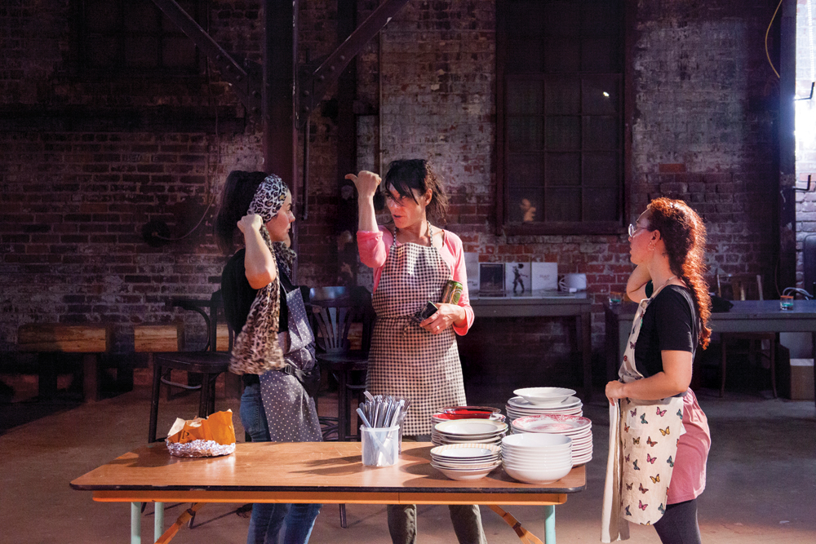
ARTWORK

Slide 9
ARTWORK
Art demonstrates Canadians serve food orphans, street kids.
Is a sign of love, affection and responsibility..
Other pieces of art shows people having fun (Shafer, 2019).
Playing with children in children's homes.
The art builds on the theme of love, care and a sense of responsibility as the celebration is after
Notes:
The piece of art shows people having fun, paying with the children in the children's home after paying them a visit and bringing what they have.
The art builds on the theme of love, care and a sense of responsibility as the celebration is after

Slide 10
ARTWORK
This art was done by Andreja Dugandžic´and Sonja Zlatanova’s performance for the 2017 VIVA! Kitchen. Courtesy Viva! Art Action/La Centrale.

Slide 11
CONCLUSION
Knowledge is power, should be shared.
Sharing is the greatest virtue.
Canadians find satisfaction in sharing.
Sharing is a way of expressing love.
Love is the most powerful affection.
Notes:
Knowledge is power and passing it to other people is the best way to use our acquired information as demonstrated by the poet through writing.
Sharing is a great virtue that speaks volume,, no matter what we give so long as it is from the heart then it is the greatest act.
The people of Canada have really demonstrated that no man is too poor that they can say they have nothing to give while no man is too rich that they can claim they have nothing to give.
We all are taught through the poem and artwork that we should love one another and share what we have no matter how small, it will have an impact in a persons life.
Knowledge is power and passing it to other people is the best way to use our acquired information as demonstrated by the poet through writing.
Sharing is a great virtue that speaks volume,, no matter what we give so long as it is from the heart then it is the greatest act.
The people of Canada have really demonstrated that no man is too poor that they can say they have nothing to give while no man is too rich that they can claim they have nothing to give.
We all are taught through the poem and artwork that we should love one another and share what we have no matter how small, it will have an impact in a persons life.

Slide 12
References
Chalmers, F. G. (2019). The study of art in a cultural context. In Art, Culture, and Pedagogy (pp. 95-105). Brill Sense.
Childs, S., Finnie, R., & Mueller, R. E. (2018). Assessing the importance of cultural capital on post-secondary education attendance in Canada. Journal of Further and Higher Education, 42(1), 57-91.
Harms, D. M. (2018). Hell and Fairy: The Differentiation of Fairies and Demons Within British Ritual Magic of the Early Modern Period. In Knowing Demons, Knowing Spirits in the Early Modern Period (pp. 55-77). Palgrave Macmillan, Cham.
Shafer, J. (2019). DH Lawrence's (Non) apologetic Apologia, and the Fiction of Forgiveness. Études Lawrenciennes, (49).

